Slide 1
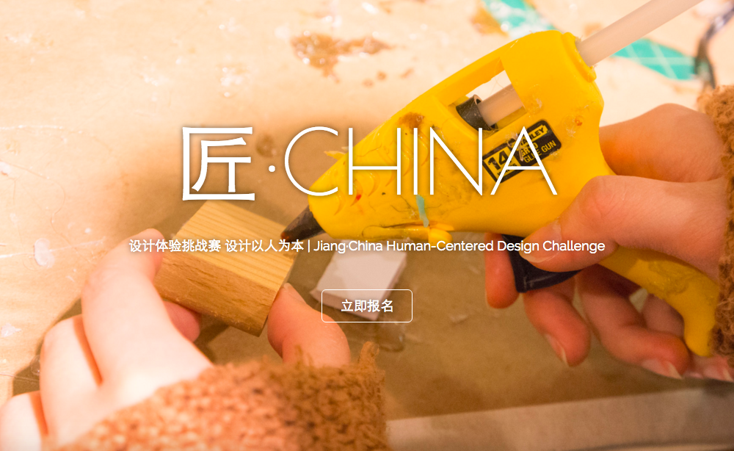
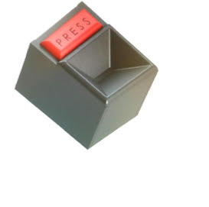
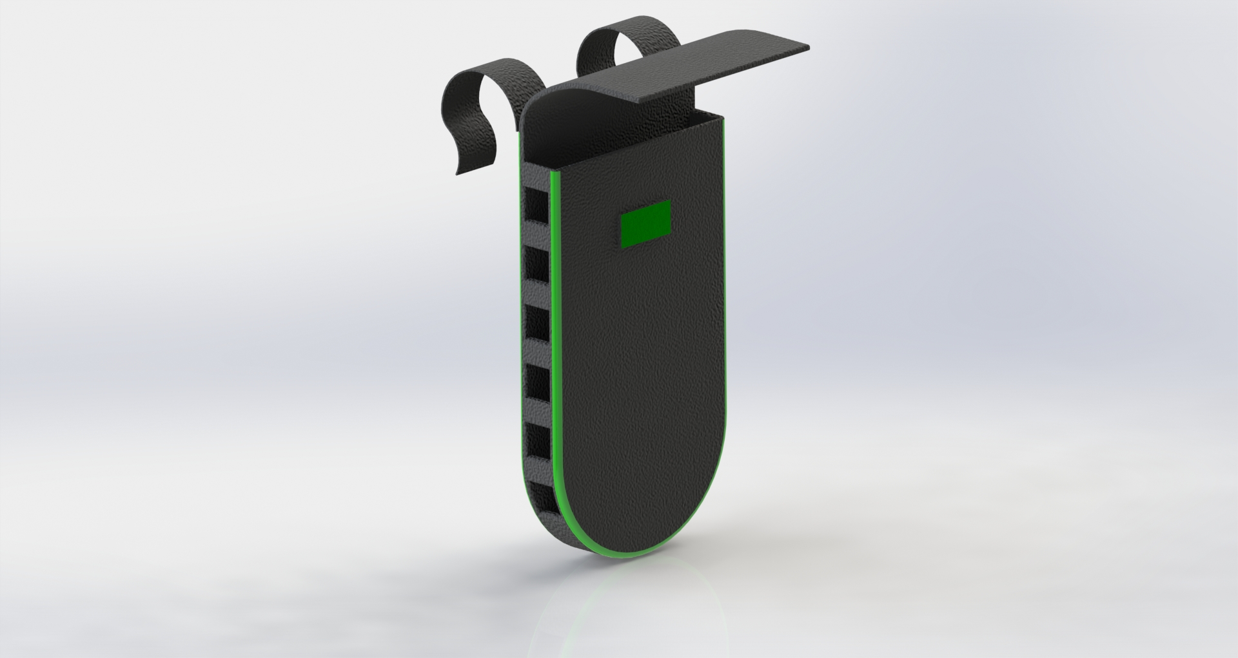
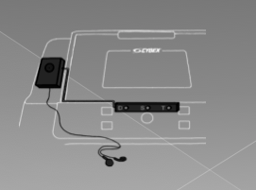

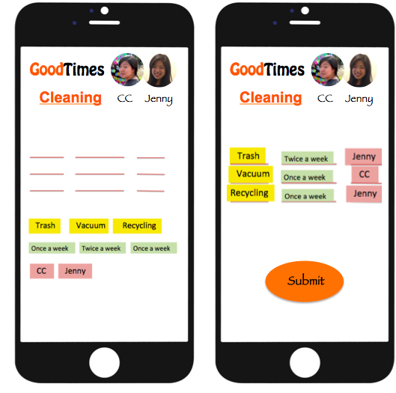
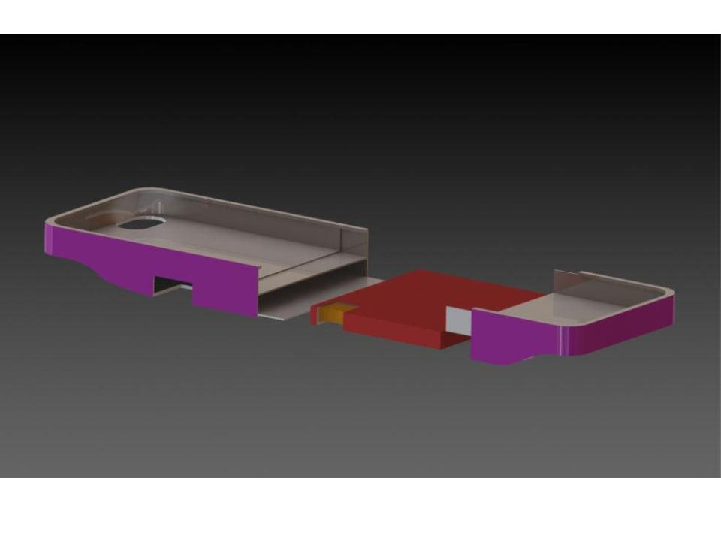
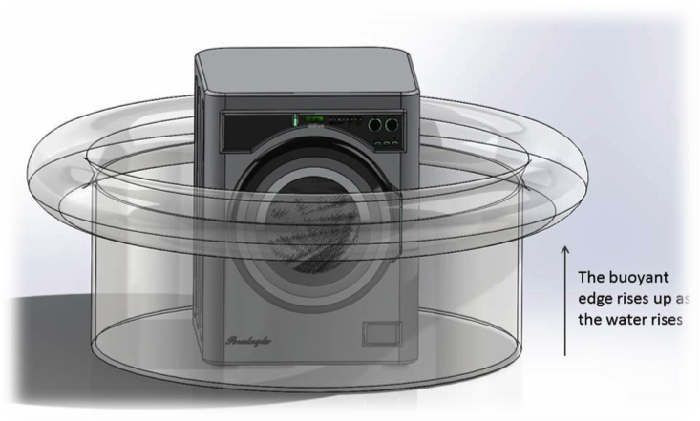
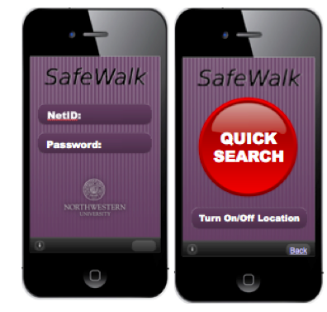
Jenny Wang
Human-Centered
Designer
Work
About
Play
jennywjs814@gmail.com
LinkedIn
Resume

Slide 2
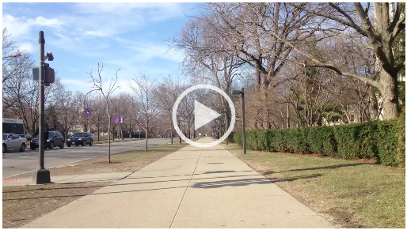
Jenny Wang
Human-Centered
Designer
Work
About
Play
Jenny Founded Jiang China Design Initiative in 2014. JCD teach human-centered design to Chinese college students who design solutions for social challenges in China.
Return
Project Page
jennywjs814@gmail.com
LinkedIn
Resume

Slide 3
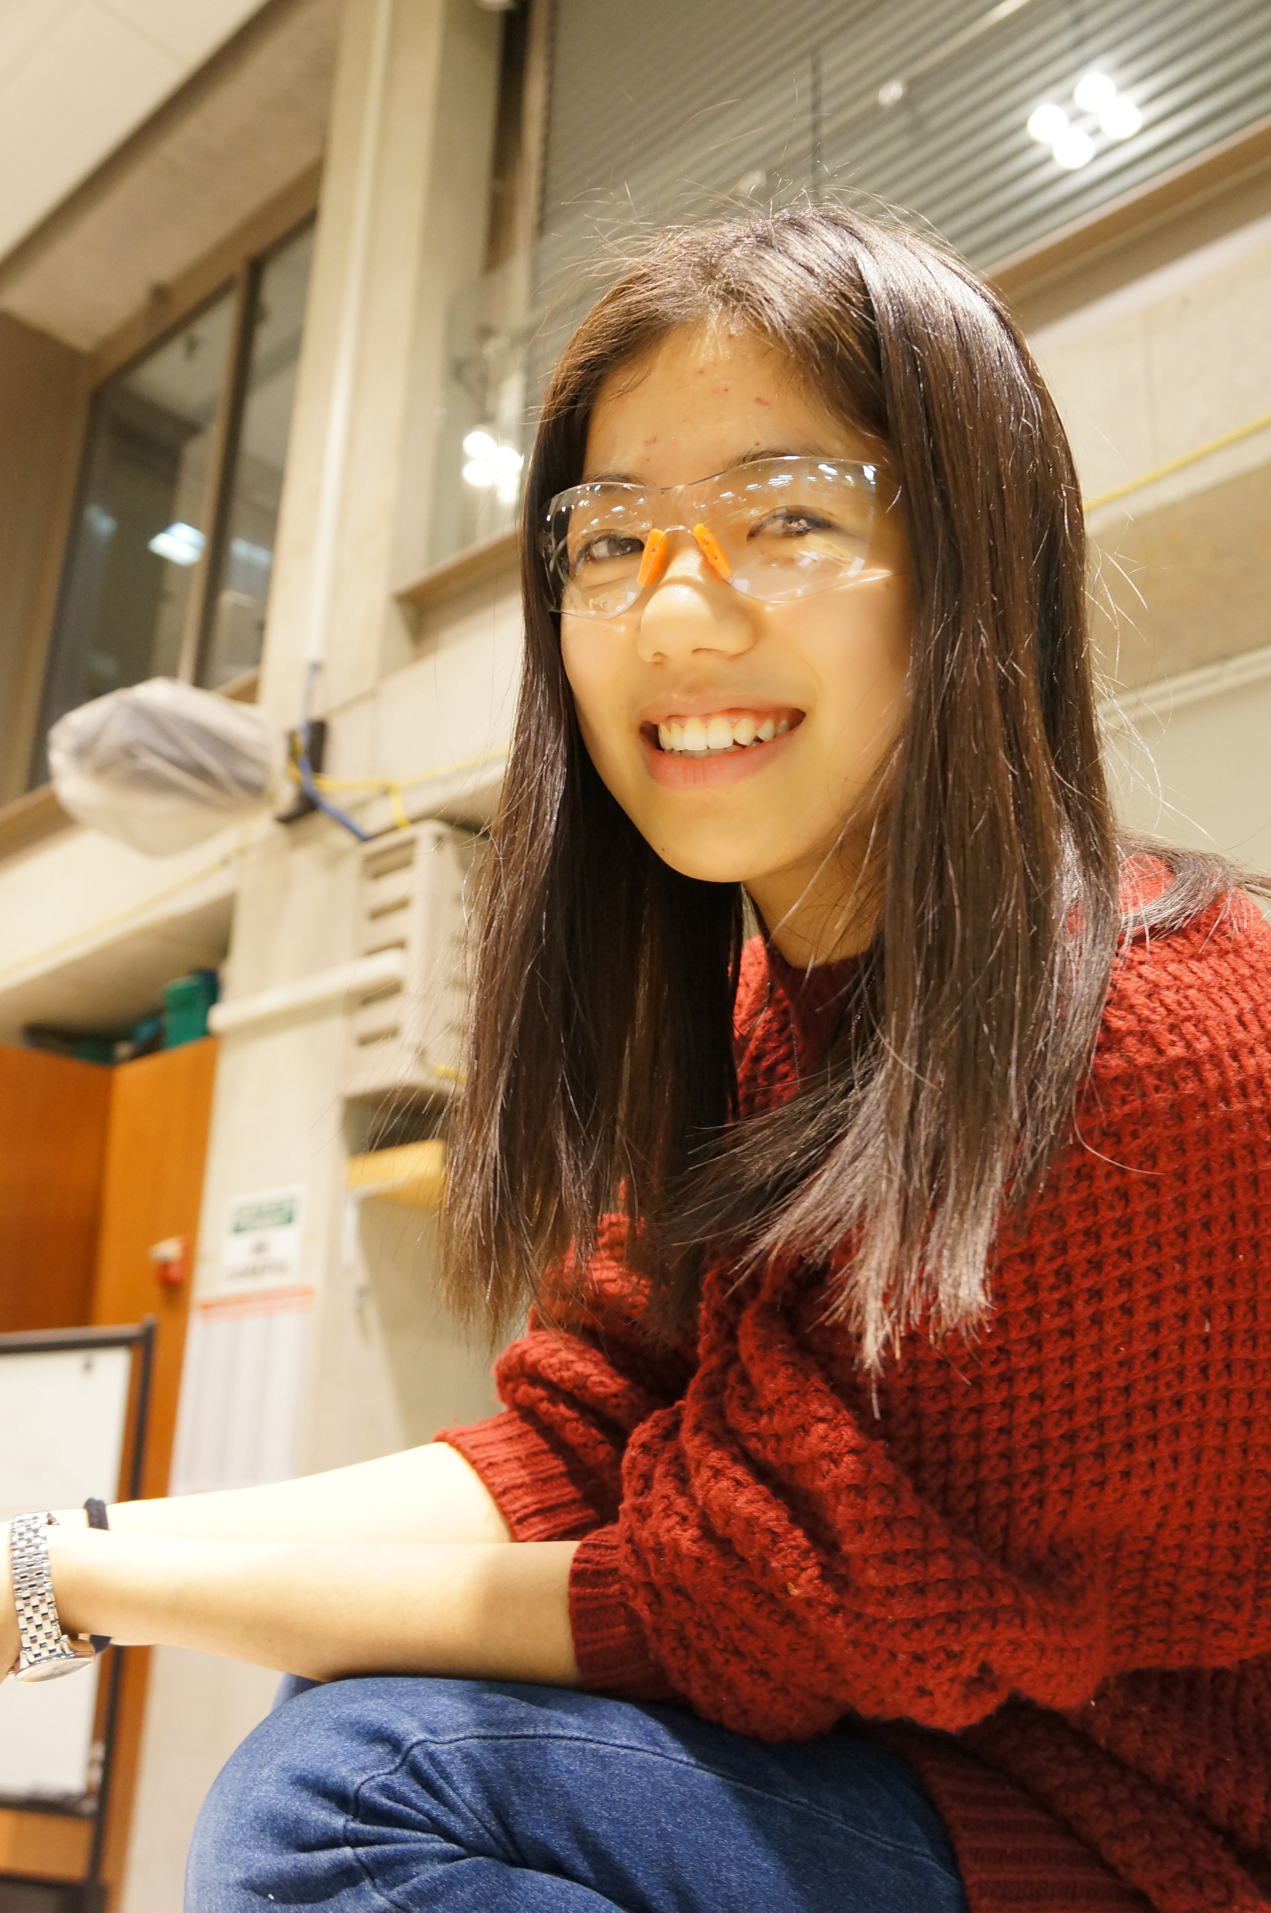
Jenny Wang
Human-Centered
Designer
Work
About
Play
Jenny Wang is a human-centered design strategist, an experimenter and a deliver. She likes using human-centered design to think and prototype, getting her hands dirty to explore and make things. She also believes that design could facilitate implementing and delivering the actual impact to the end users of a product or service. Jenny loves working on design challenges where she sees potentials for improving users’ experiences and creating meaningful impact to the society.
Jenny also founded a human-centered design organization to teach more people the human-centered design methodologies to seed impact through education.
Contact Info: jennywjs814@gmail.com
jennywjs814@gmail.com
LinkedIn
Resume

Slide 4
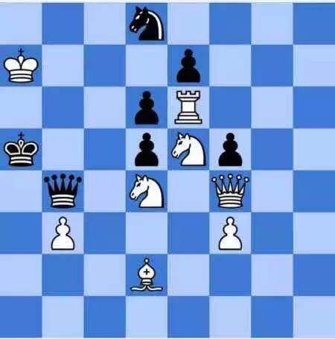
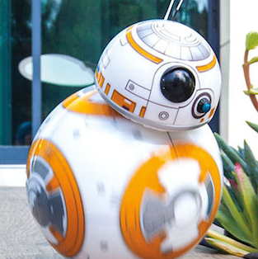
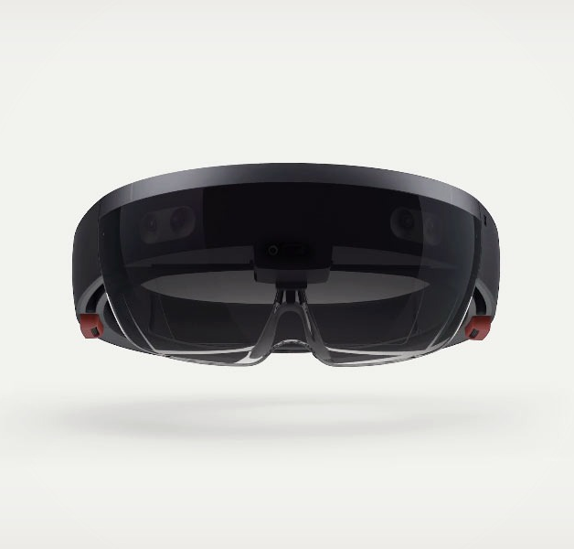
Jenny Wang
Human-Centered
Designer
Work
About
Play
White First, Two Steps, Checkmate!
Took me a really long time to figure out. Don’t rule out things easily and don’t assume. The true answer is most obvious but hard to find…Read More
My Next Favorite
When I encountered a video of this little one, I was so amazed! Yet the technology to build this is not the hardest a, but what it is conve…Read More
Went to a HoloLens Demo
Last week I went to a HoloLens Demo in Chicago and tried it. The experience is alright but my nose hurt for five day after the demo… Read More
jennywjs814@gmail.com
LinkedIn
Resume

Slide 5

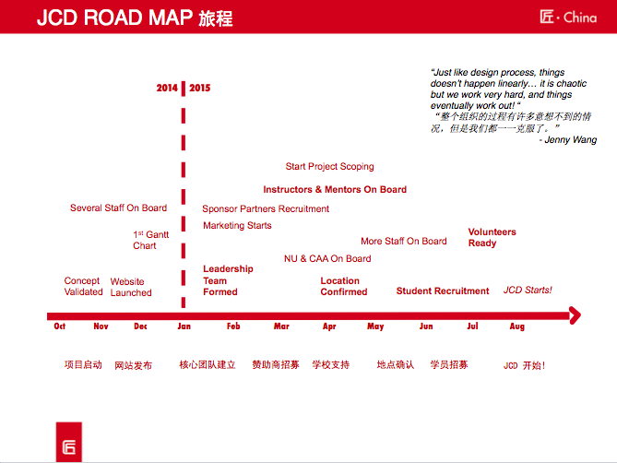
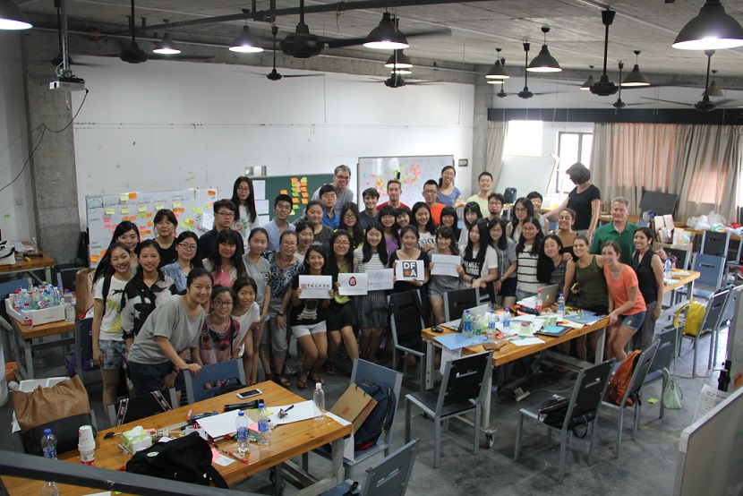
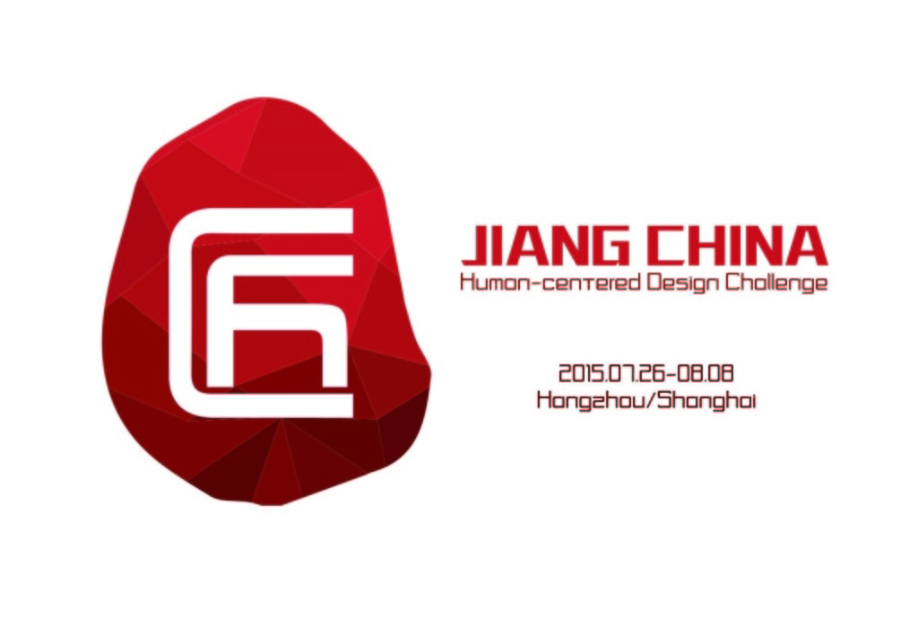
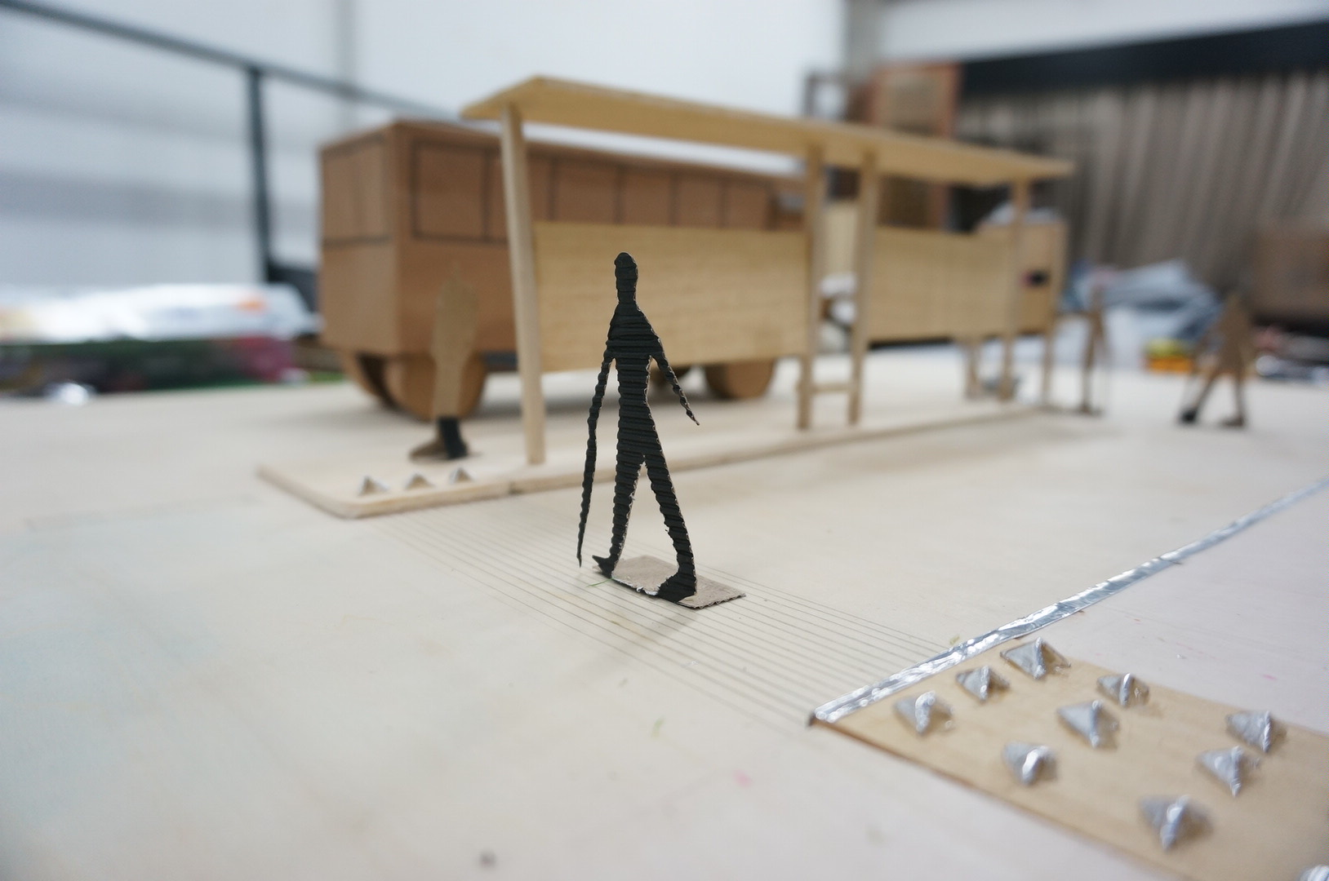
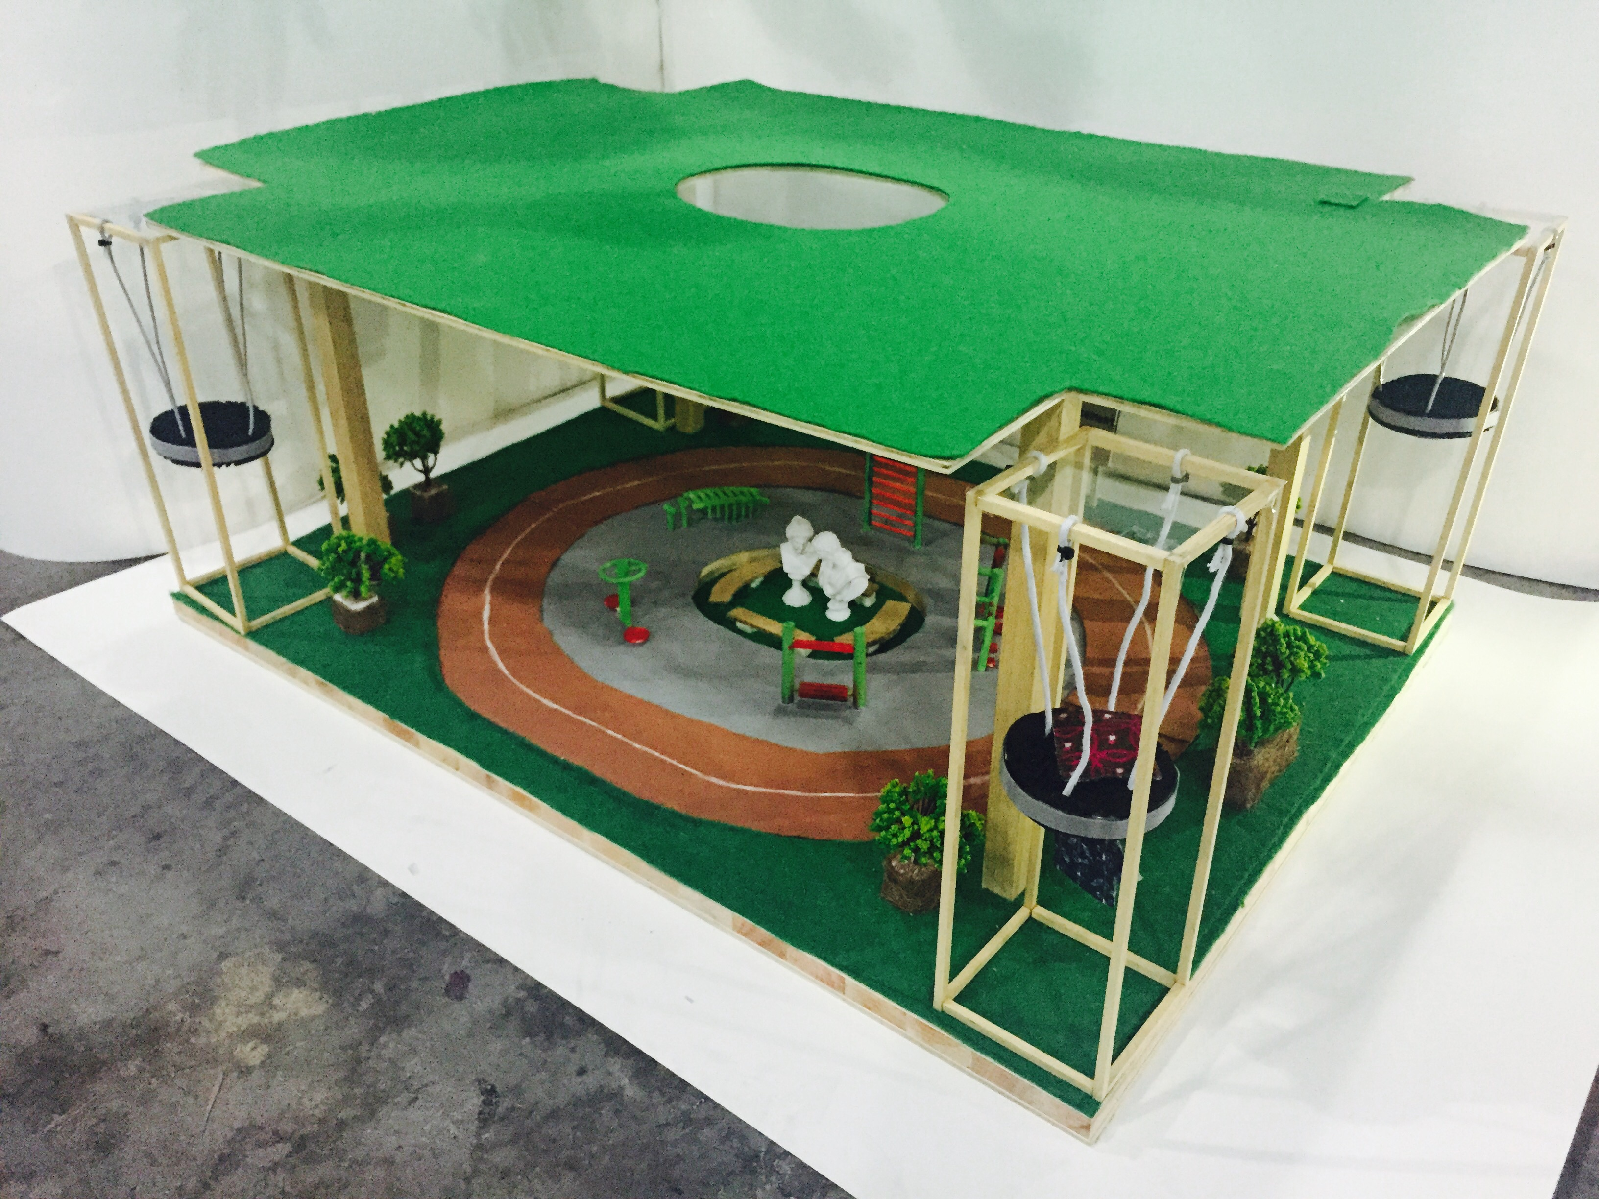
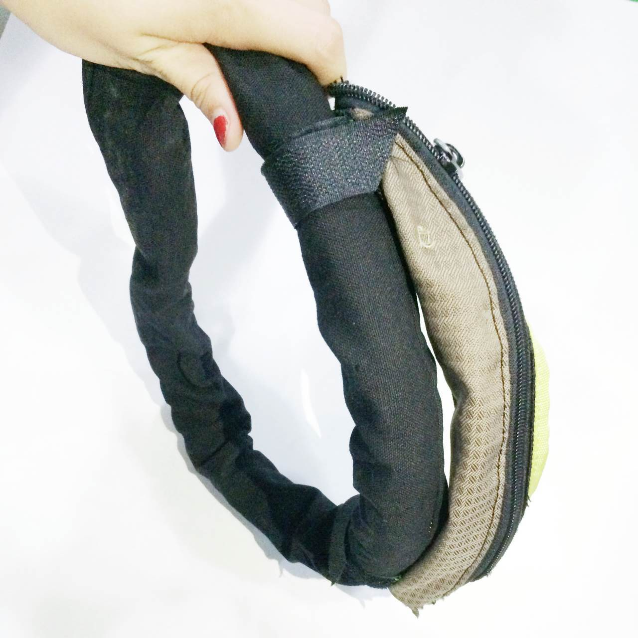
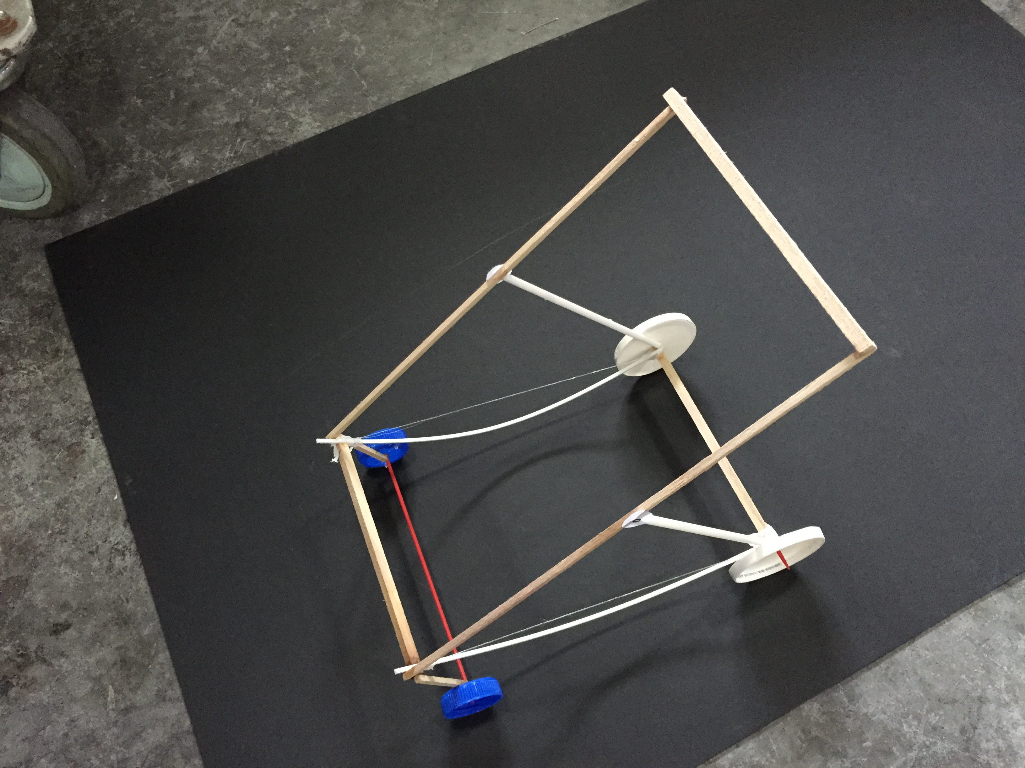
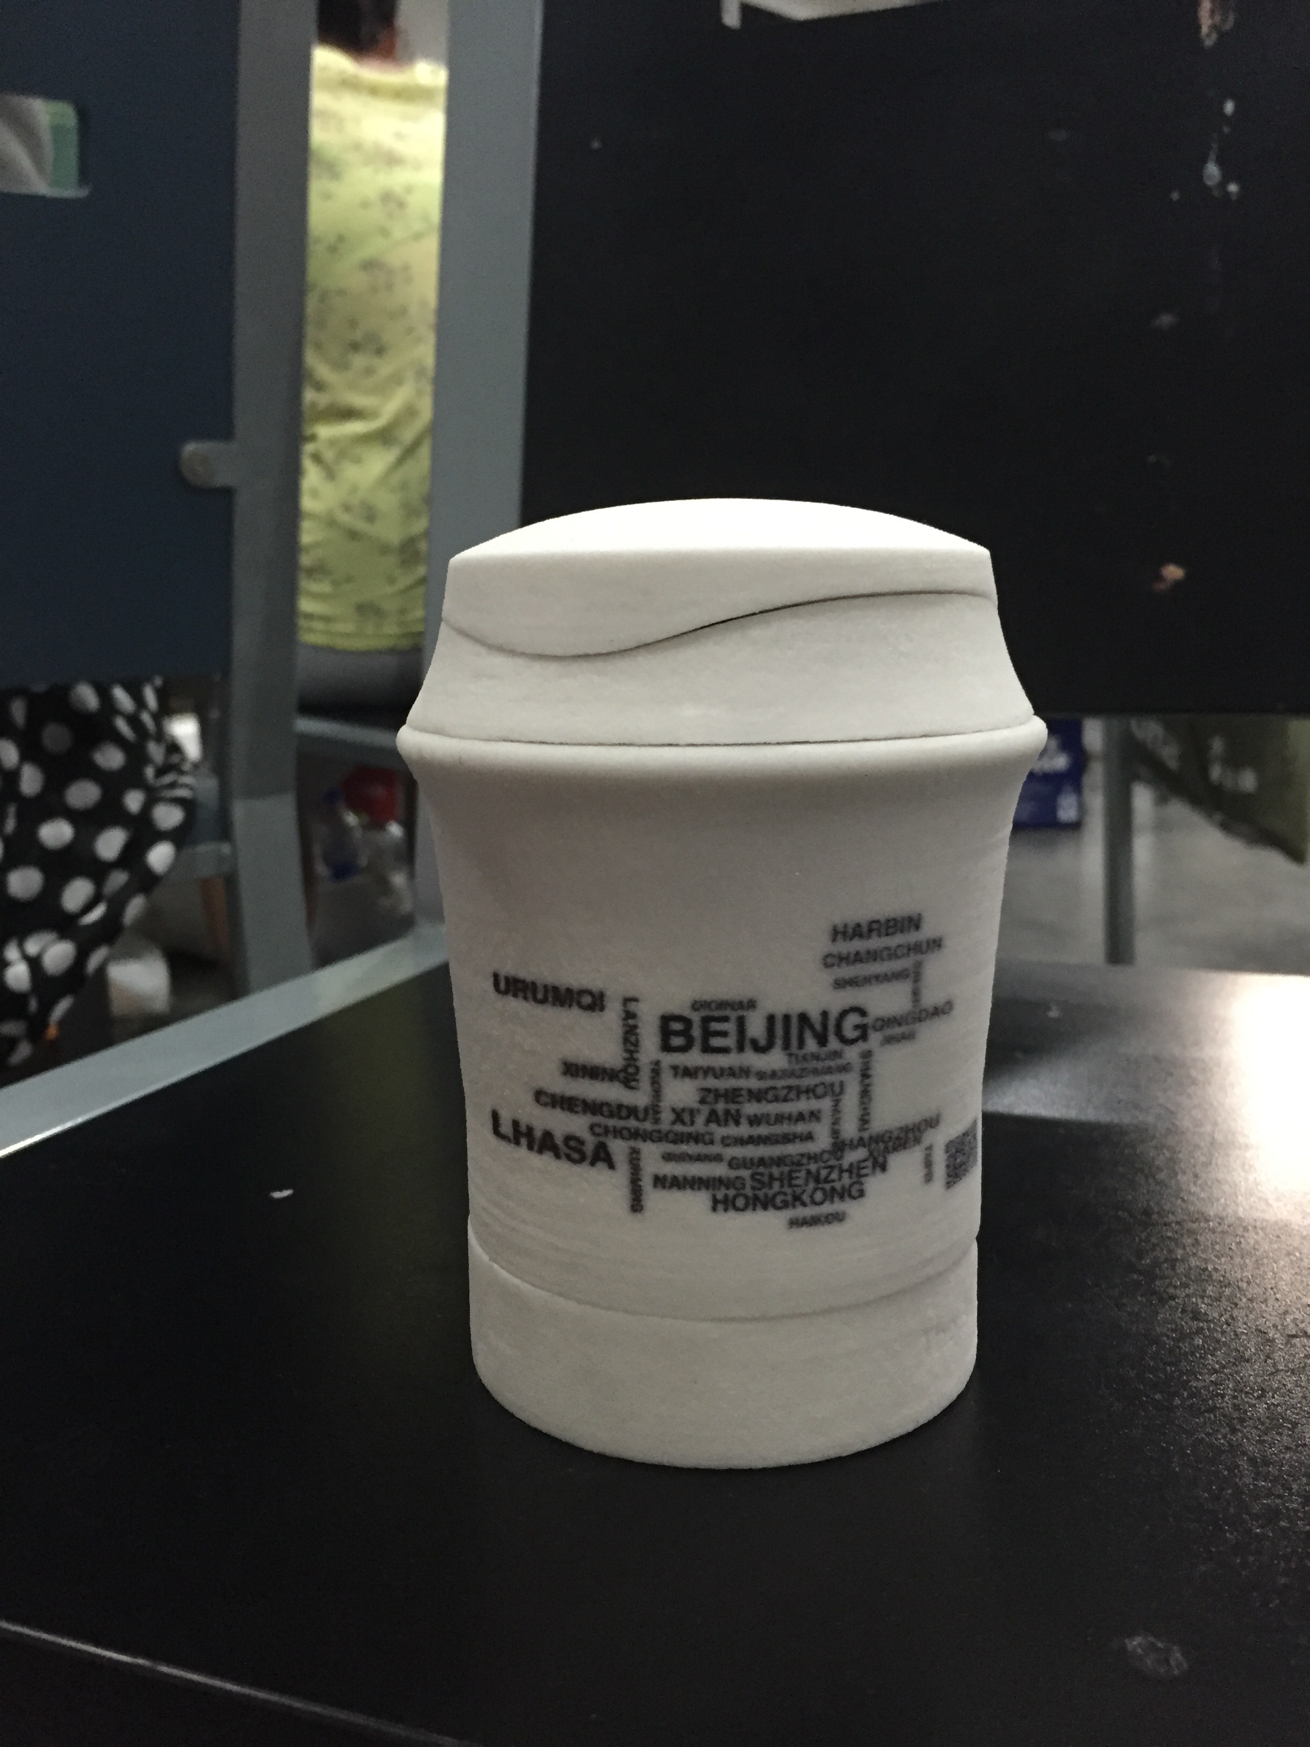
Jenny Wang
Human-Centered
Designer
Work
About
Play
Jiang China Design
Jiang China Human-Centered Design Challenge is a two-week design challenge for Chinese college students across disciplines. The website is HERE. Jenny founded this initiative in October 2014, and has been
The following is a roadmap of how we designed this design challenge and brought it to life.
jennywjs814@gmail.com
LinkedIn
Resume

Slide 6
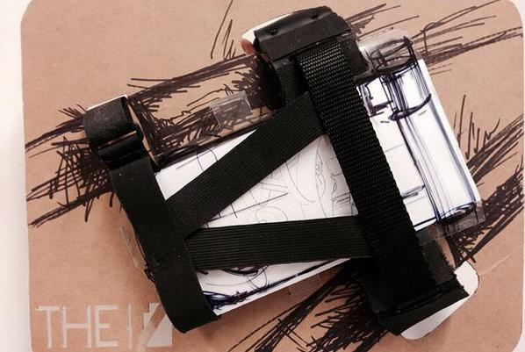
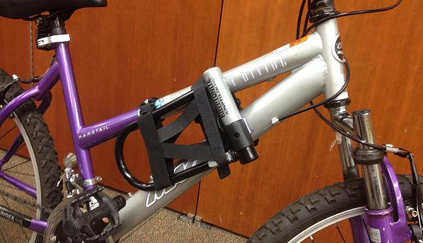
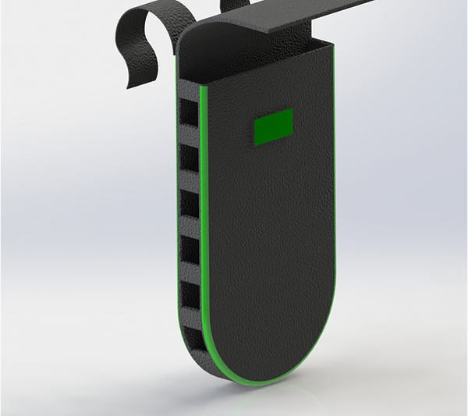
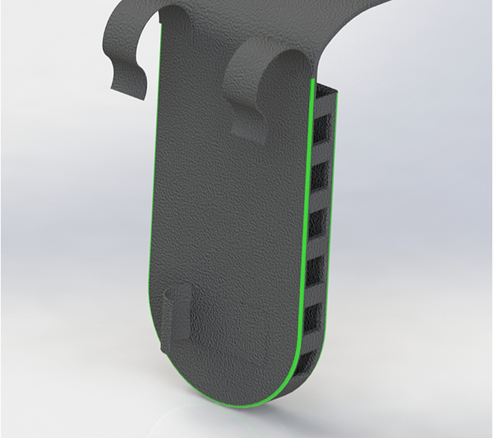
Jenny Wang
Human-Centered
Designer
Work
About
Play
The V
V is a design of a new U Lock storage system that improves the Locking and Unlocking experience. V is installed on the bike frame, and users can simply plug in their U Lock into V before riding, and take the U Lock out of V when wanting to lock their bike. V is elastic and fits a variety of different U lock and bike frames.
jennywjs814@gmail.com
LinkedIn
Resume

Slide 7
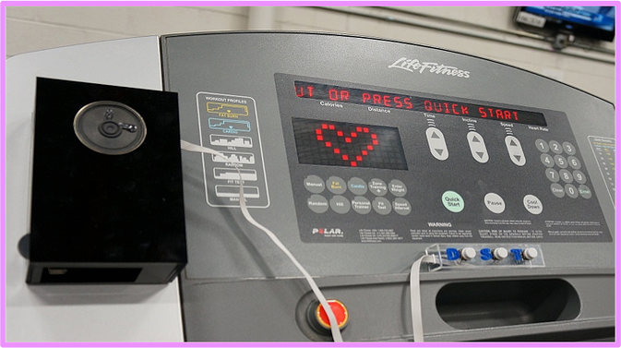
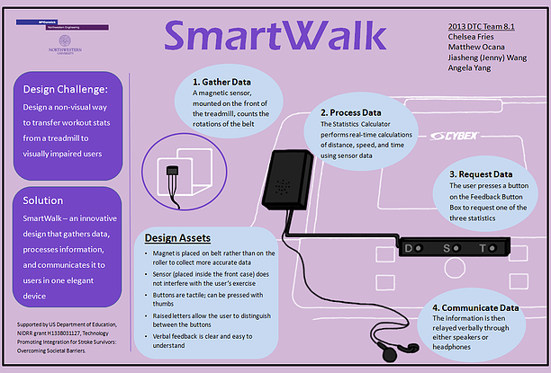
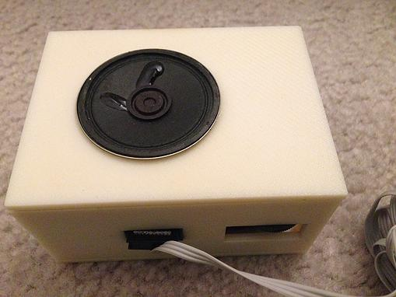
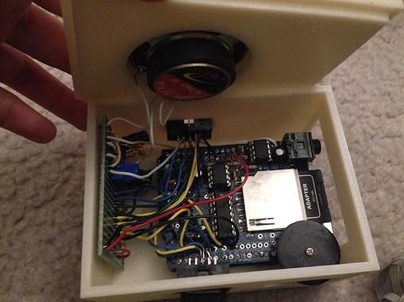
Jenny Wang
Human-Centered
Designer
Work
About
Play
Smart Walk
SmartWalk is an automatic feedback device for visually impaired people to receive exercise feedback in a non-visual way. Using a magnetic sensor to track the rotations of the treadmill’s belt, SmartWalk sends this information to a Statistics Calculator mounted in the treadmill cup holder which keeps a continuously updated calculation of time, distance, and speed. Users can request time, distance, or speed feedback at any time using the button box, and after a request is made, SmartWalk quickly reads that data to the user in a human voice through either headphones or a speaker.
jennywjs814@gmail.com
LinkedIn
Resume

Slide 8
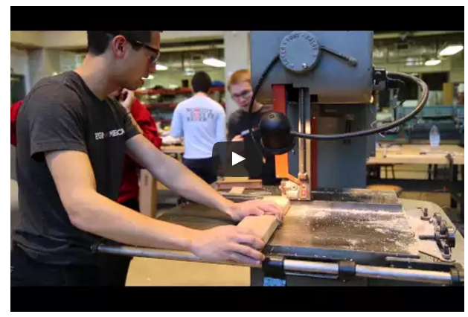
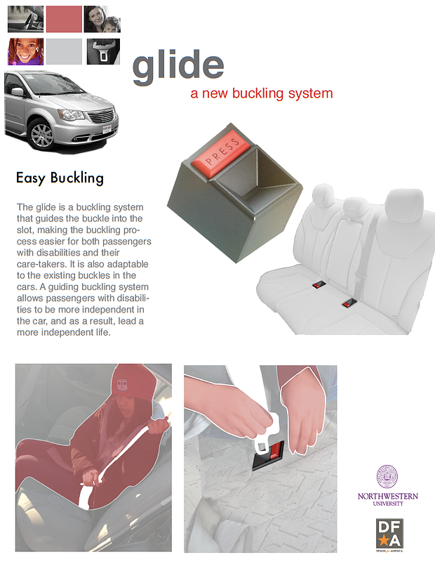
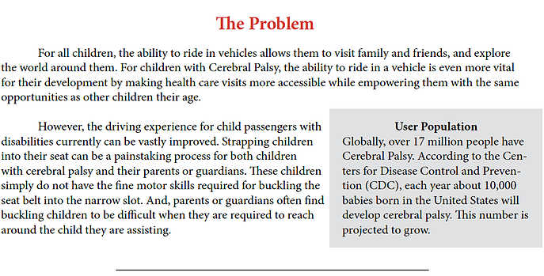
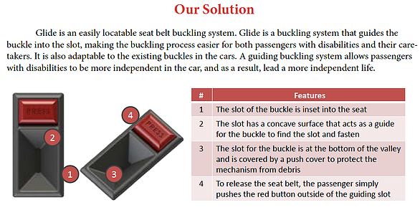
Jenny Wang
Human-Centered
Designer
Work
About
Play
The Glide
Glide is a buckling system that guides the buckle into the slot, making the buckling process easier for both passengers with disabilities and their care takers. It is also adaptable to esiting buckles in the cars. A guiding buckling system allows passengers to be more independent in the car, and as a result, lead a more confident life. Project Glide is sponsored by Chrysler.
jennywjs814@gmail.com
LinkedIn
Resume

Slide 9
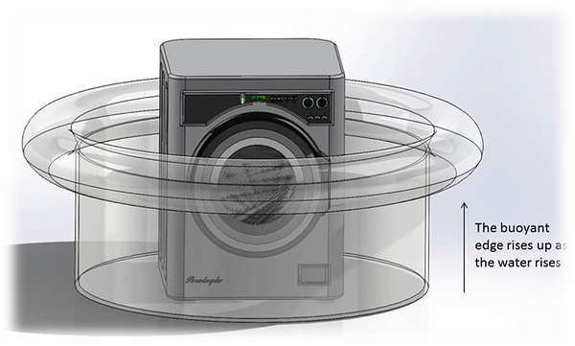
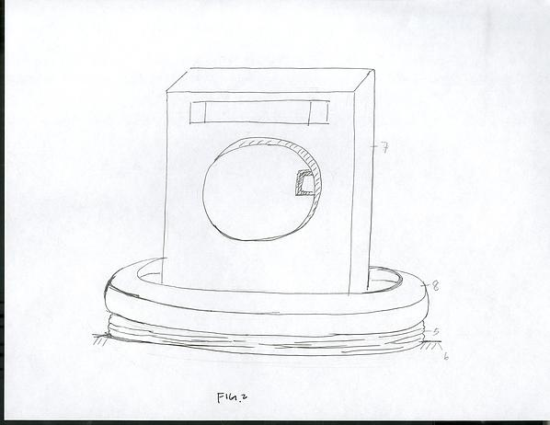
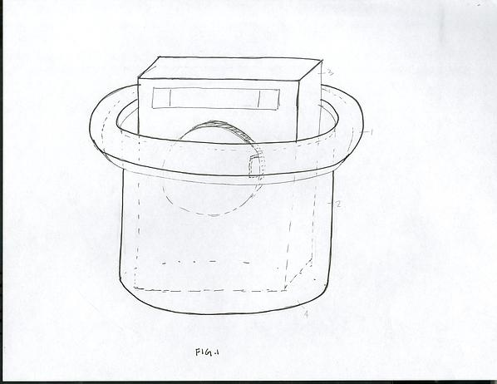
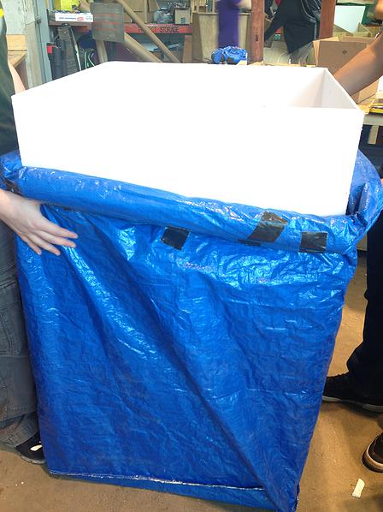
Jenny Wang
Human-Centered
Designer
Work
About
Play
Urban Flooding
Urban Flooding Project is a one year project designed an apparatus that protects basement appliances. This apparatus is a special bag that has a buoyant edge on the top of it. The basement appliances sit in the bag, and the bag sits on the ground before flooding. During the flooding, the buoyant force pushes the buoyant part up, and raise up the entire bag to cover the appliances, protecting it from being damaged by flooding. This design is currently under provisional patent application.
jennywjs814@gmail.com
LinkedIn
Resume

Slide 10
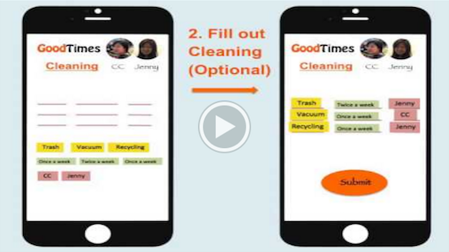
Jenny Wang
Human-Centered
Designer
Work
About
Play
Good Times
Jiang China Human-Centered Design Challenge is a two-week design challenge for Chinese college students across disciplines. The website is HERE. Jenny founded this initiative in October 2014, and has been
jennywjs814@gmail.com
LinkedIn
Resume

Slide 11
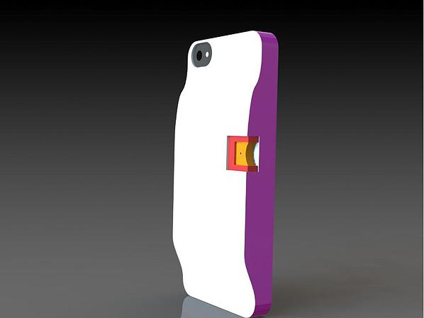

Jenny Wang
Human-Centered
Designer
Work
About
Play
Hand Spray
Helping Hand is a phone case that has an inserted spray system. This spray system contains hand sanitizers, and helps users to have easy access to hand sanitizers, improving their hand hygiene. Hand Sanitizers in contained in slim cards that can be easily disposed and refilled.
jennywjs814@gmail.com
LinkedIn
Resume

Slide 12
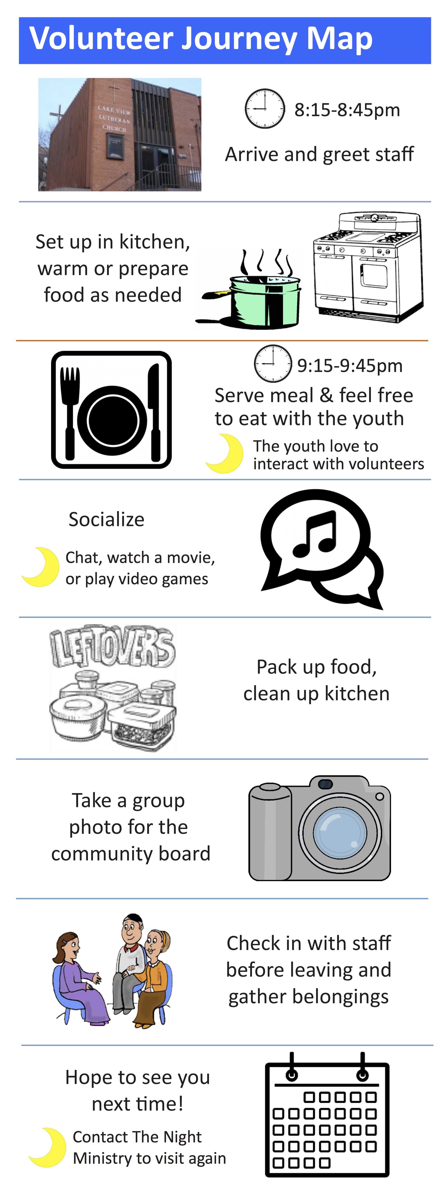
Jenny Wang
Human-Centered
Designer
Work
About
Play
Night Ministry
Jiang China Human-Centered Design Challenge is a two-week design challenge for Chinese college students across disciplines. The website is HERE. Jenny founded this initiative in October 2014, and has been
jennywjs814@gmail.com
LinkedIn
Resume

Slide 13
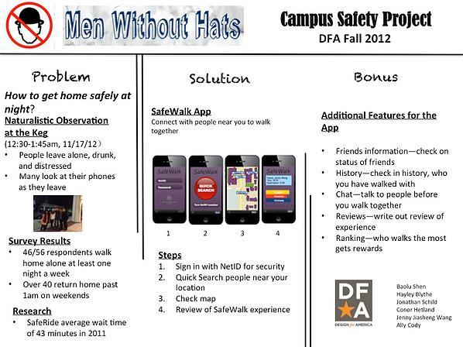
Jenny Wang
Human-Centered
Designer
Work
About
Play
Campus Safety
Project Campus Safety Designed an App called Safe Walk for improving campus safety at night. This App helps students to find walking partners who are going to close destinations from close starting locations at night.
jennywjs814@gmail.com
LinkedIn
Resume

